Slide 1
Tetris X
team: spirits
team members: Jiaming Zhao(Po)
Yilin Xu (SM Sprint1)
Xuanyi Zhang (SM Sprint2)
Weiyi Xia (SM Sprint3)
Date: 2017/7/23

Slide 2
Motivaiton
Tetris X is a mobile app runs on the Android platform
Gain mobile app coding experience
Gain game coding experience

Slide 3
Goals Set Out to Achieve
A functional Tetris Game
- Buttons for Block movement and rotation
- Row cancels when its full and update rest of block positions
- Game user score features
A functional login and register system
A Tetris game with multiple difficulty levels
A functional user score ranking function

Slide 4
Goals have achieved
A functional Tetris Game
A functional login and register system
A Tetris game with multiple difficulty levels

Slide 5
Goals did not achieve
A functional user score ranking function:
- We are able to upload and download score data
- We are not able to print out data in game due to type converting issues

Slide 6
Challenges
We have 0 experience on coding mobile apps.
We have to learn the way of using developing tools like Unity and Firebase.
We have to figure out the way of building project into mobile devices

Slide 7
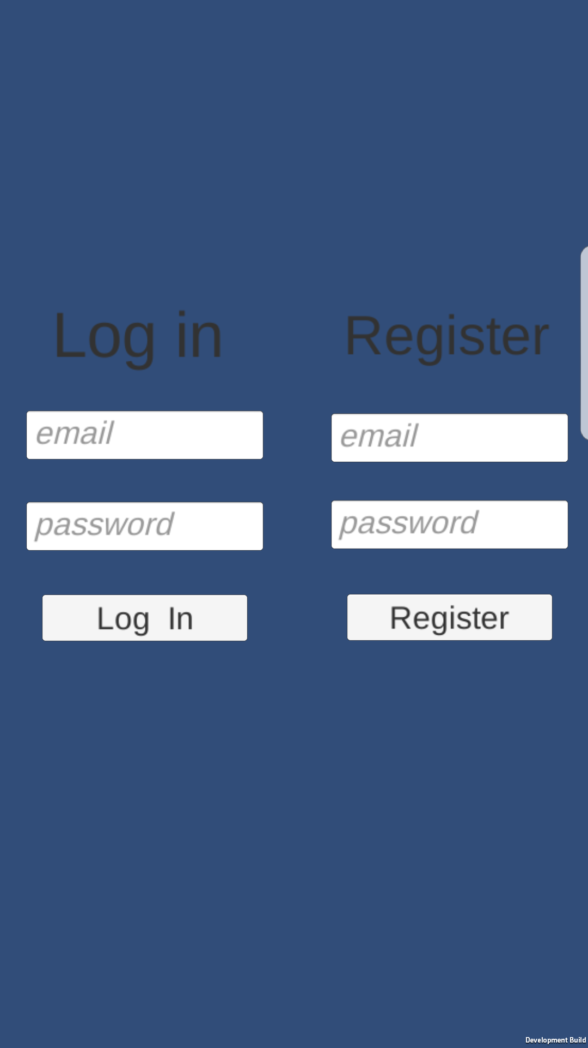
Tetris X Overview
The Login and Register Page
- user name (e-mail format)
- password

Slide 8
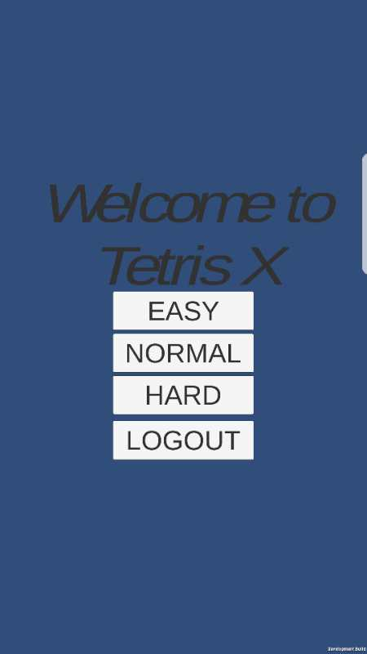
Tetris X Overview
Game Start Page
Difficulty selection
- easy: 1 unit falling speed, least score, fix location
-normal: 2 unit falling speed, medium score, fix location
- hard: 5 unit falling speed, most score, random location
Logout function

Slide 9
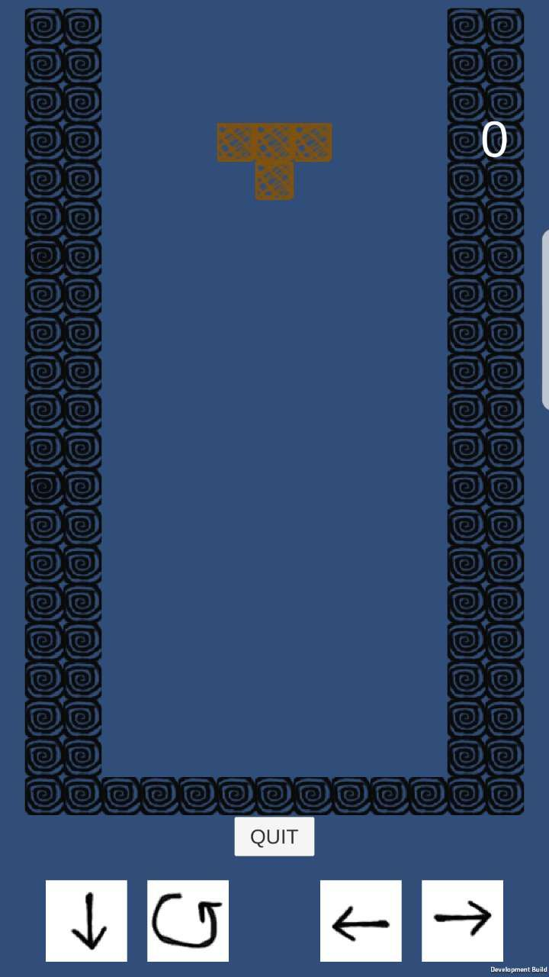
Tetris X Overview
Game Content Page
- Within the boundary is the game area
- Score is shown on the top right corner
- Down button
- Rotate button
- Left button
- Right button
- Quit button

Slide 10
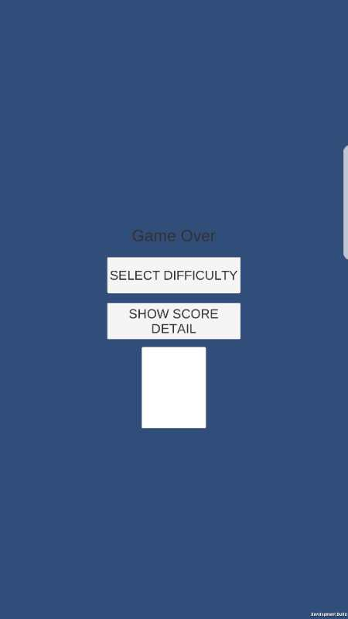
Tetris X Overview
Game Over Page
- Select Difficulty jump back to game start page
- Show Score Difficulty prints out top five players' information

Slide 11
Tetris X Demo
https://youtu.be/8HlSOa9SaLE

Slide 12
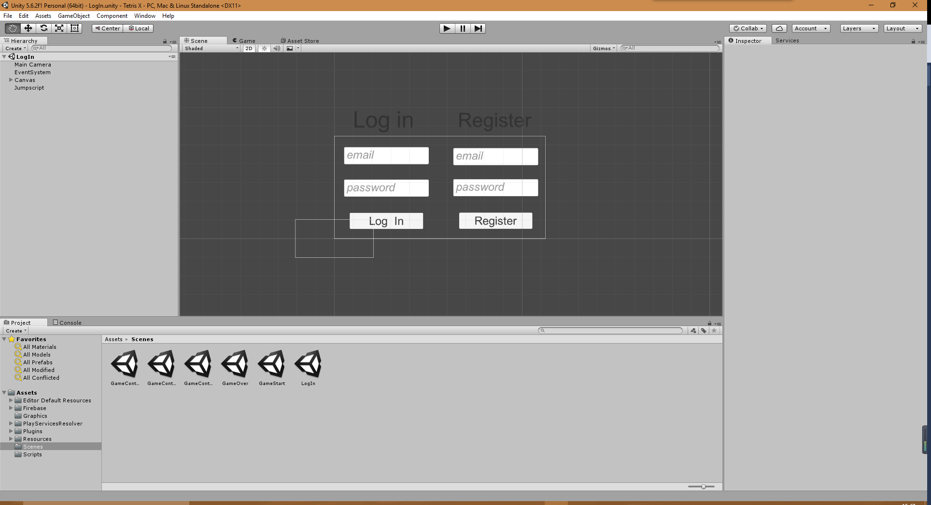
Technologies
Unity:
We use scenes to store the design of game pages

Slide 13
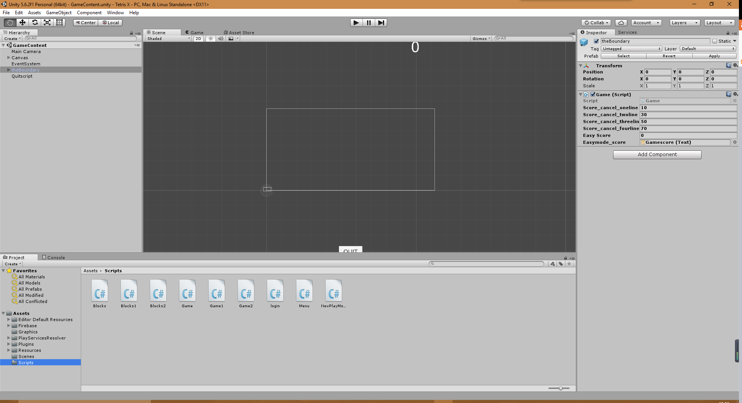
Technologies
Unity:
We use scripts to store code.
Code are attached to each game object in order to make the game object work

Slide 14
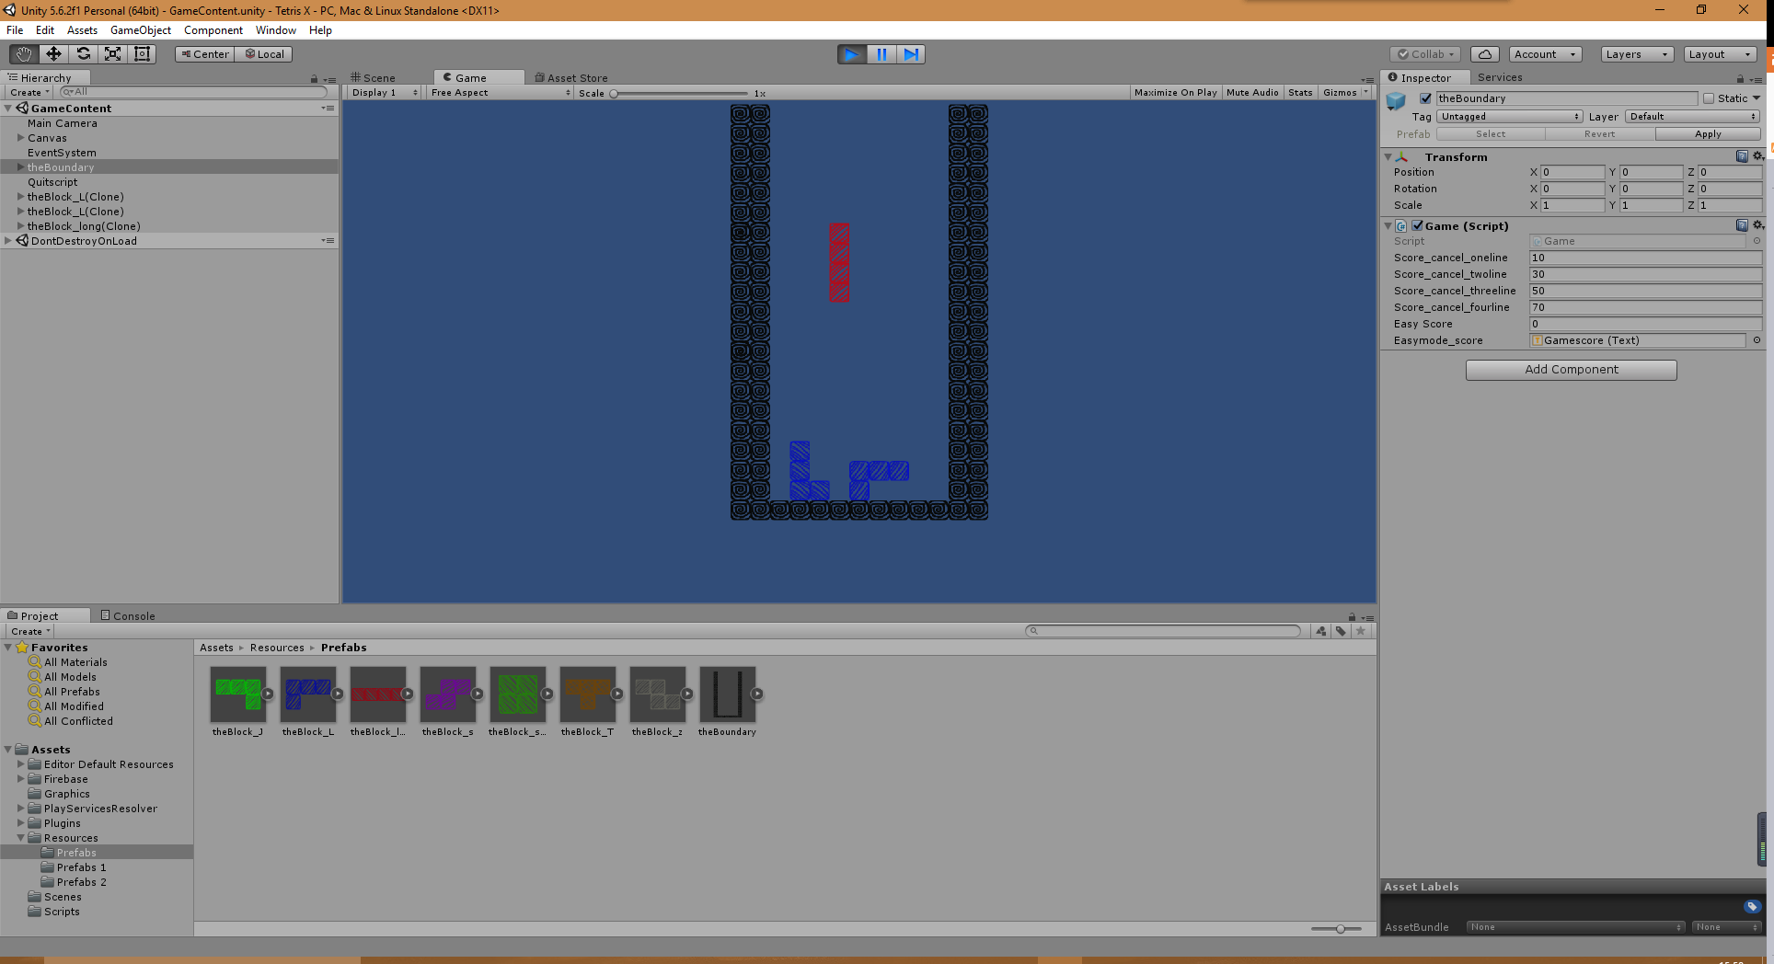
Technologies
Unity:
We use Resource to store Gameobjects which would run code written in the attached scripts

Slide 15
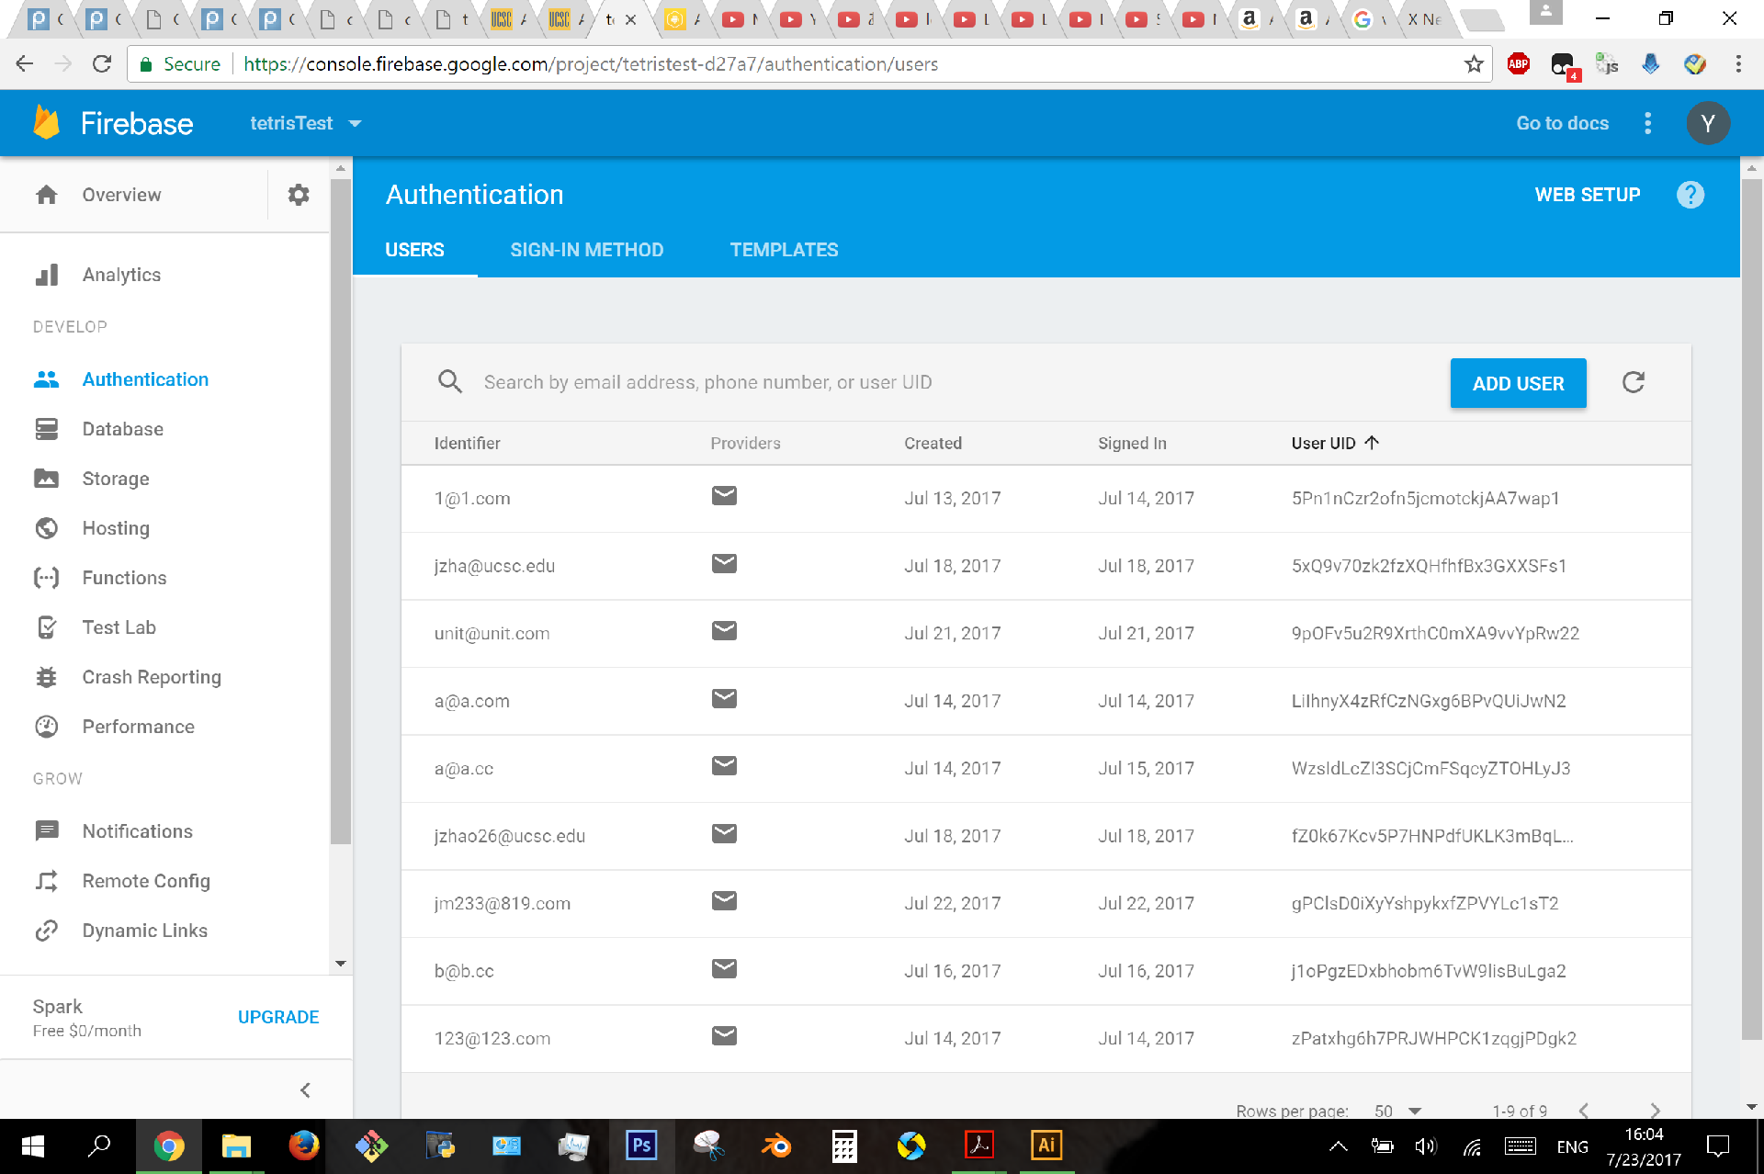
Technology
Firebase:
We use firebase to store user register information.
By calling firebase methods, we achieved login and register functions.

Slide 16
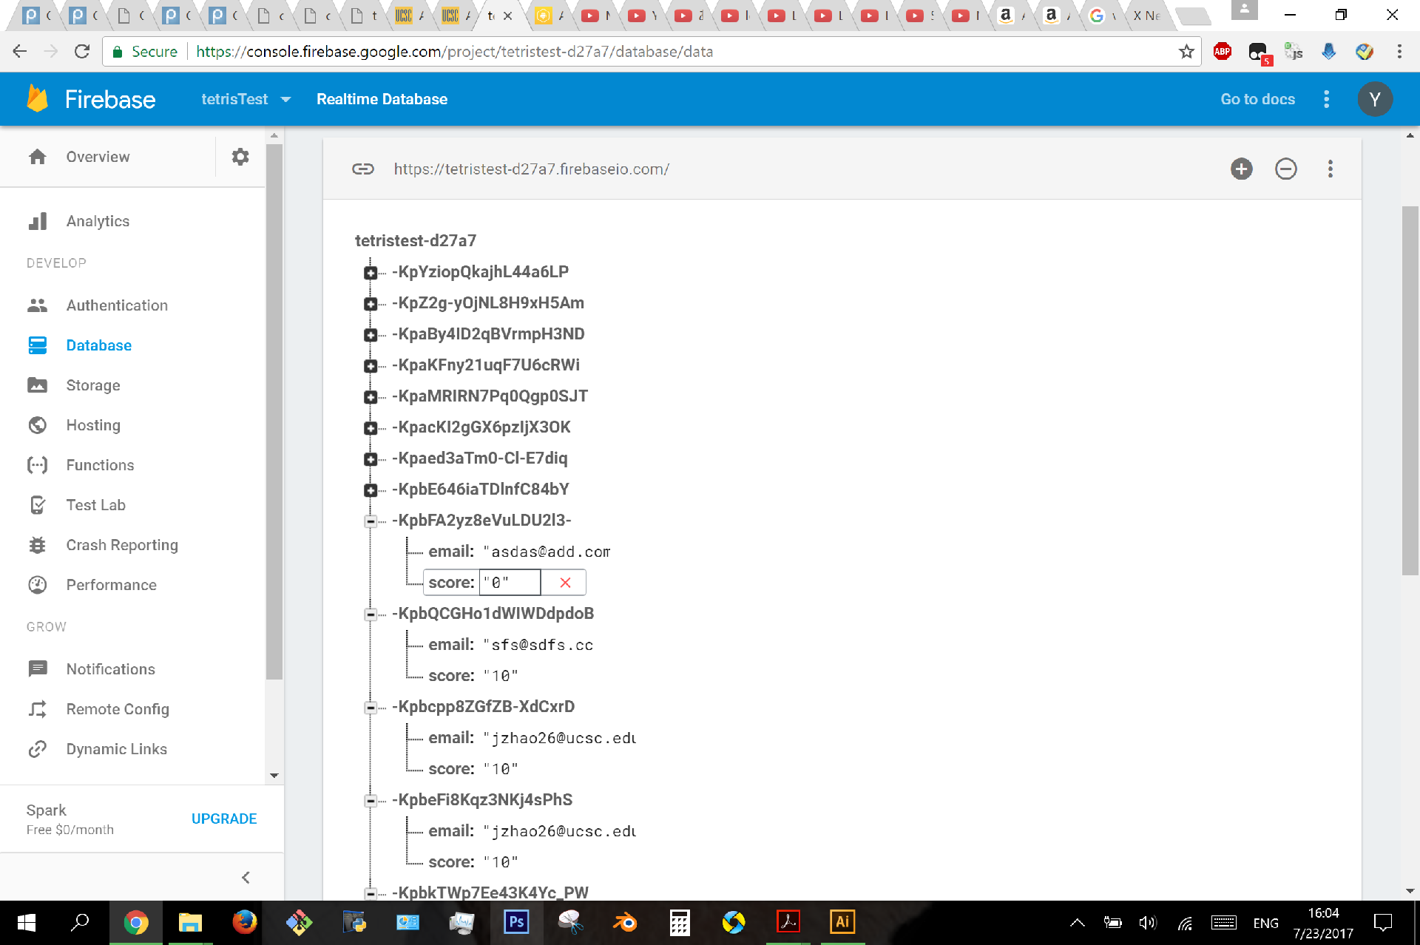
Technology
Firebase:
We use firebase to store user scores once the game is over.
Each user data has an unique key followed by their username and game score

Slide 17
Project Management Techniques
Scrum development framework:
- three sprints in total
- three scrum meetings every week
- keep contact using social communication app called Wechat
- github to store all documents and codes for each sprint

Slide 18
Summary
We enjoyed the experience of collaborative working
We enjoyed the experience of developing mobile apps
We did not enjoy the development period, it is too short.

Slide 19
Summary
We will keep doing the scrum management techniques in the future, it is a great development mode to be used.
We will keep using Unity for gaming development, it is a great development software.
We will not use Firebase in the future, it is hard to use and causes so much trouble for us.
We wish we could finish the online ranking funciton for our game in the future.

Slide 20
Thanks for Watching!

